Slide 1
BASIC TIPS ON HOW TO BECOME A PROGRAMMER
Prepared By Emil Shulman

Slide 2
ARE YOU SICK OF YOUR CURRENT CAREER?
YES? I HAVE A DECISION!

Slide 3
WHAT DOES A COMPUTER PROGRAMMER DO?

Slide 4
HOW TO BECOME A PROGRAMMER:
STEP BY STEP GUIDE

Slide 5
Step 1:
UNDERSTAND WHY YOU WANT TO START PROGRAMMING

Slide 6
ANSWERS & DECIDE:
Why do you want to learn programming?
What do you hope to do with your new knowledge?
Are you serious about learning to program?
What sort of programming do you want to do?

Slide 7
Step 2:
DECIDE WHAT FIELD YOU WANT TO GO INTO

Slide 8
MOST POPULAR TYPES OF PROGRAMMERS:
Web developers
Software programmers
Data scientists
Database Administrator
Mobile app development
Other Roles

Slide 9
Step 3:
LEARN A PROGRAMMING LANGUAGE (OR THREE)

Slide 10

WHAT ABOUT PYTHON?

Slide 11
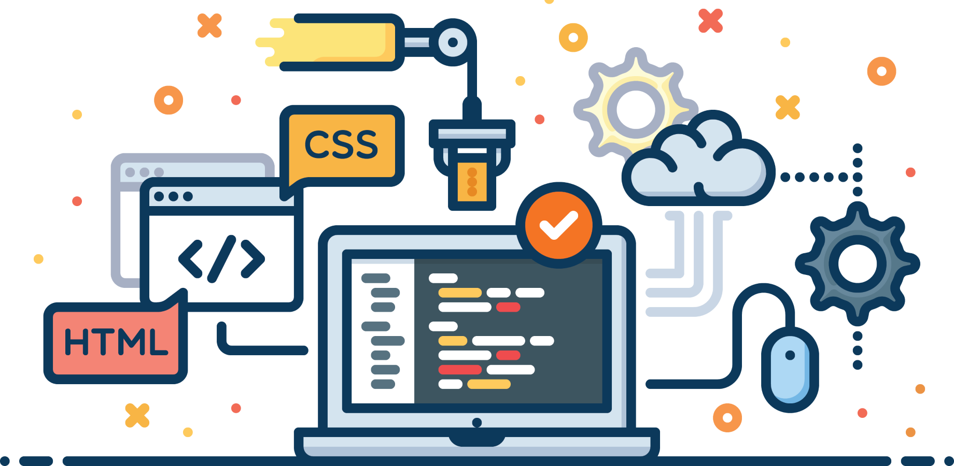
OR MAYBE CSS/HTML?

Slide 12
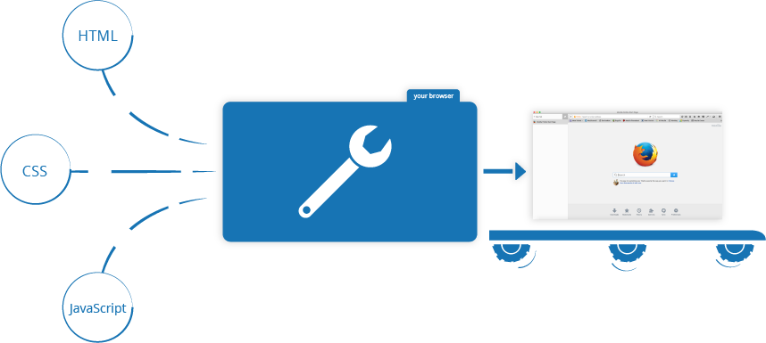
...OR JAVASCRIPT?

Slide 13
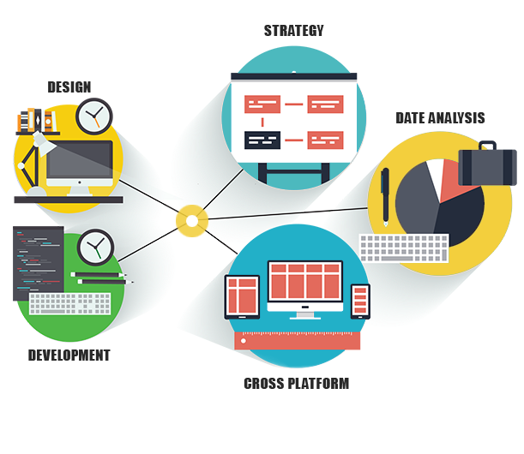
ALSO WE HAVE A
JAVA!

Slide 14


TALK ABOUT SWIFT...

Slide 15


...AND SOLIDITY.

Slide 16
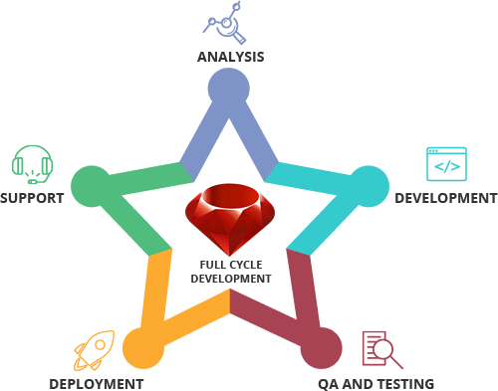
THE LAST -
RUBY!

Slide 17
Step 4:
PRACTICE, PRACTICE &
PRACTICE SOME MORE

Slide 18
Step 5:
START BUILDING A PORTFOLIO OF WORK

Slide 19
Step 6:
APPLY FOR JOBS

Slide 20
Step 7:
NEVER STOP LEARNING

Slide 21
THANK YOU FOR WATCHING

